Slide 1

#LifeKoKaroLift
Working with Git & Github
Powell Menezes

Slide 2



Lecture On : Git & Github
Instructor : Powell Menezes
Powell Menezes

Slide 3
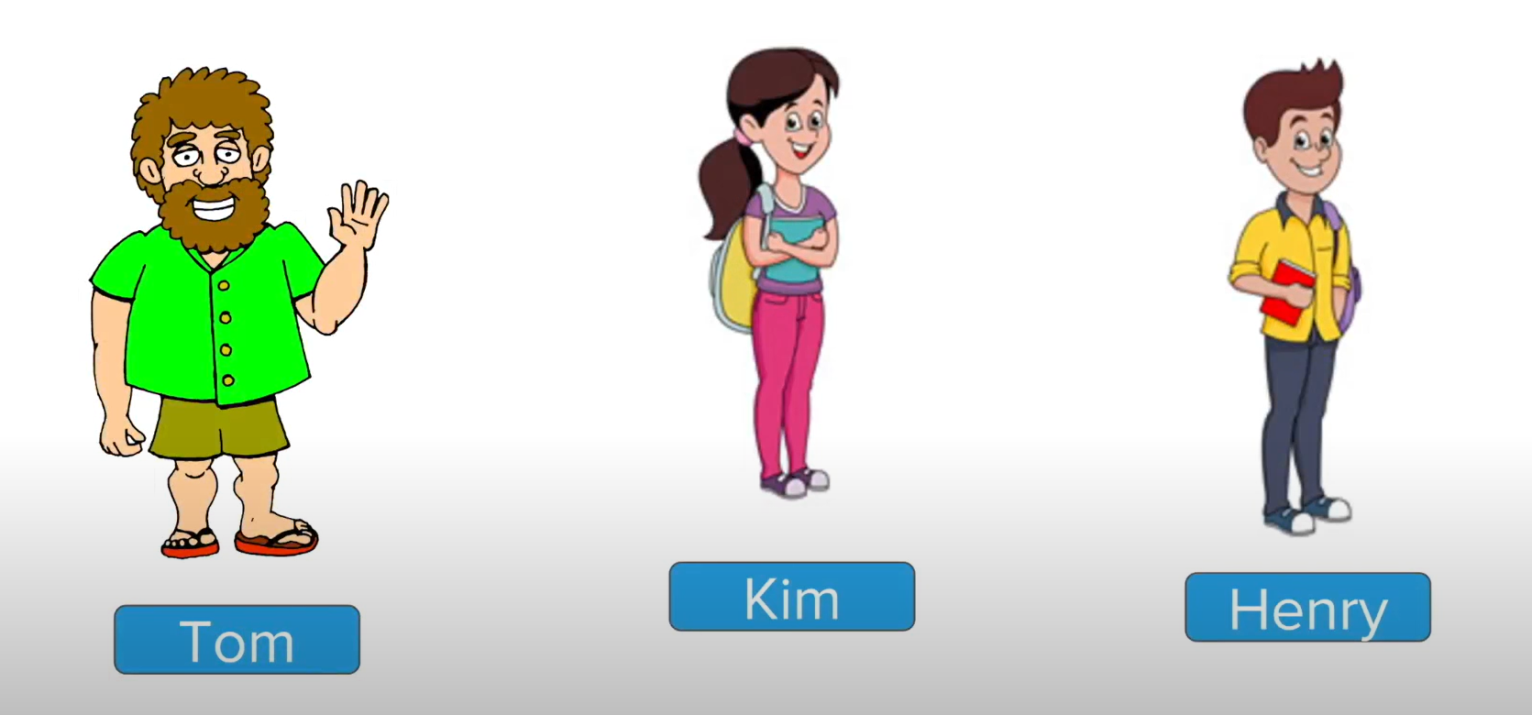
Powell Menezes

Slide 4

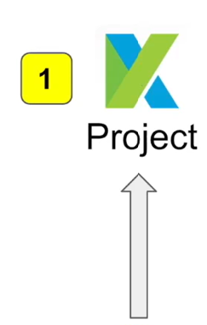
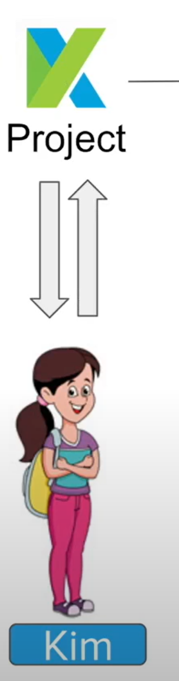
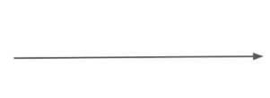
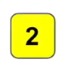
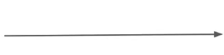
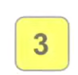


Global Plastic Waste Data
Error prone
Manual
Inefficient
Time consuming
Powell Menezes

Slide 5
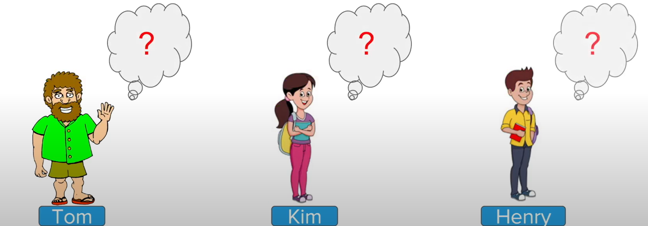
Powell Menezes

Slide 6
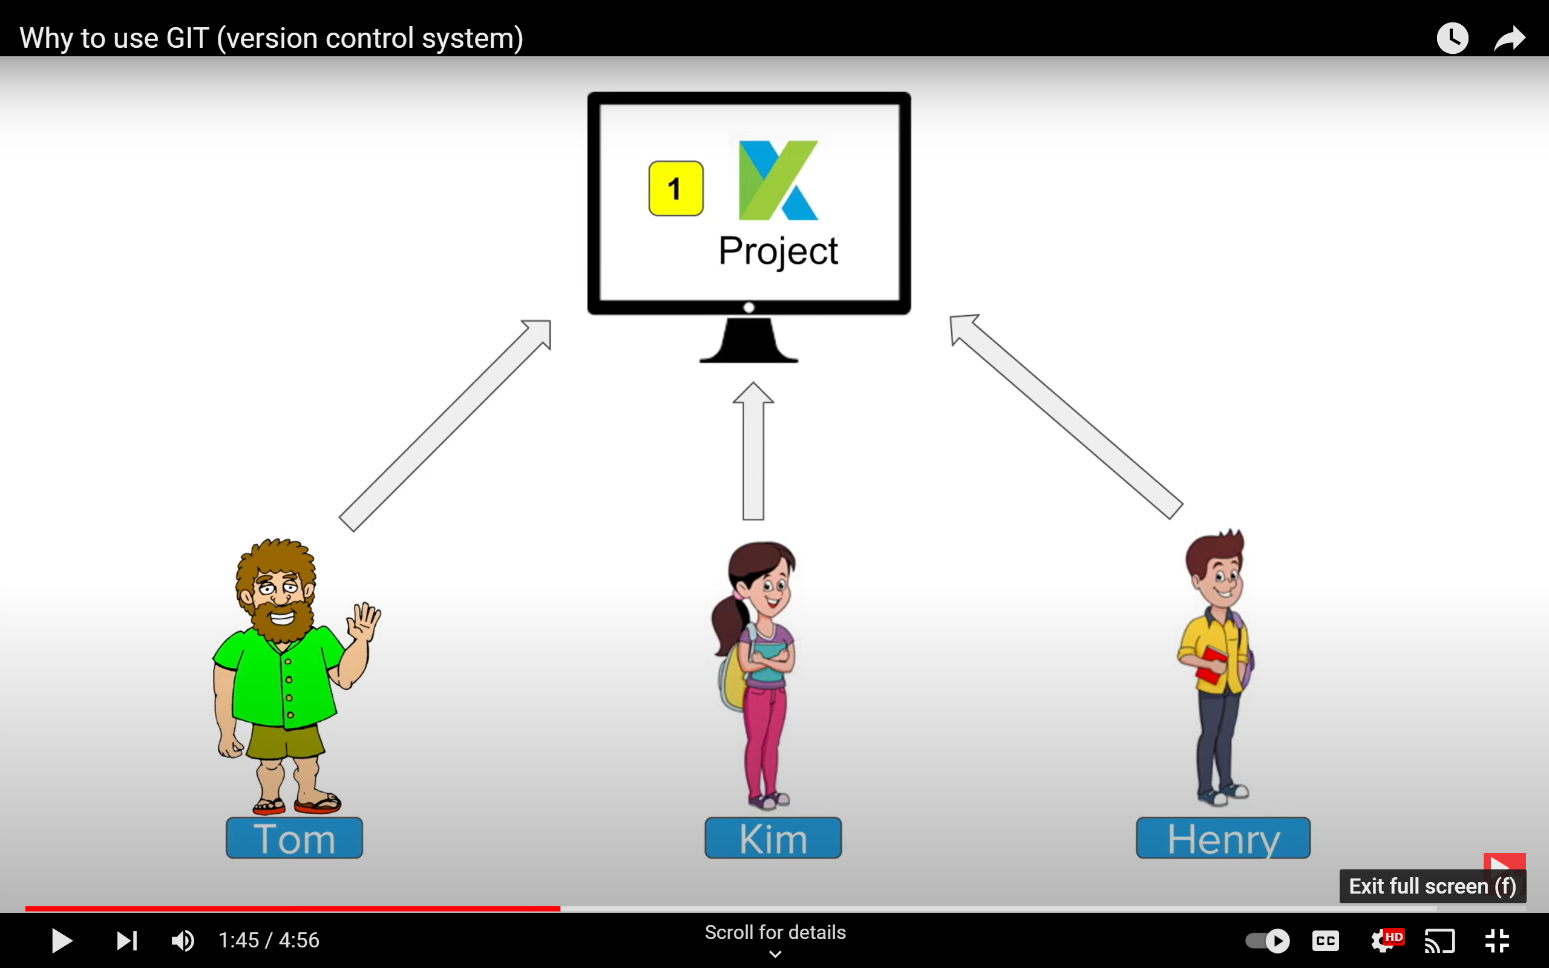
Time consuming
Manual
Inefficient
Powell Menezes

Slide 7
Powell Menezes

Slide 8

Powell Menezes

Slide 9

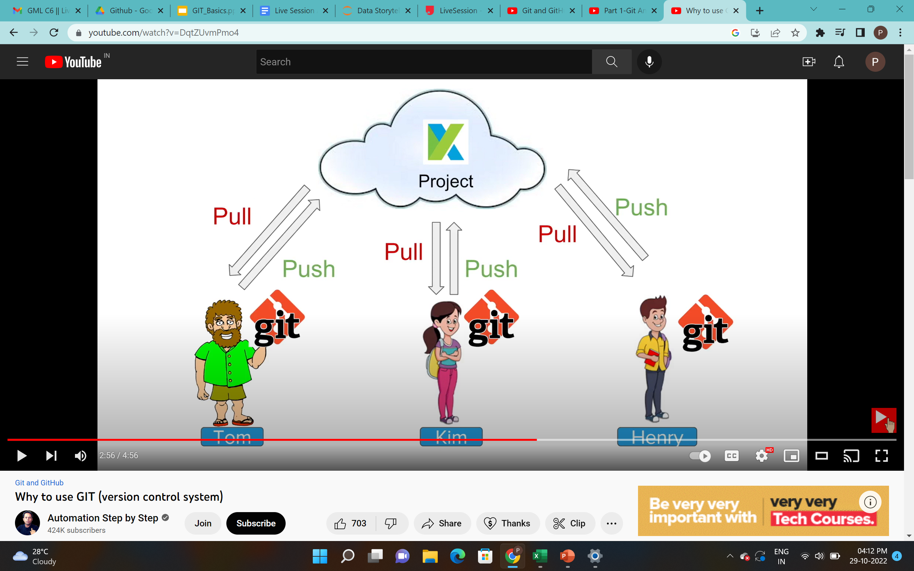
Push
Push
Push
Pull
Pull
Pull
Powell Menezes

Slide 10
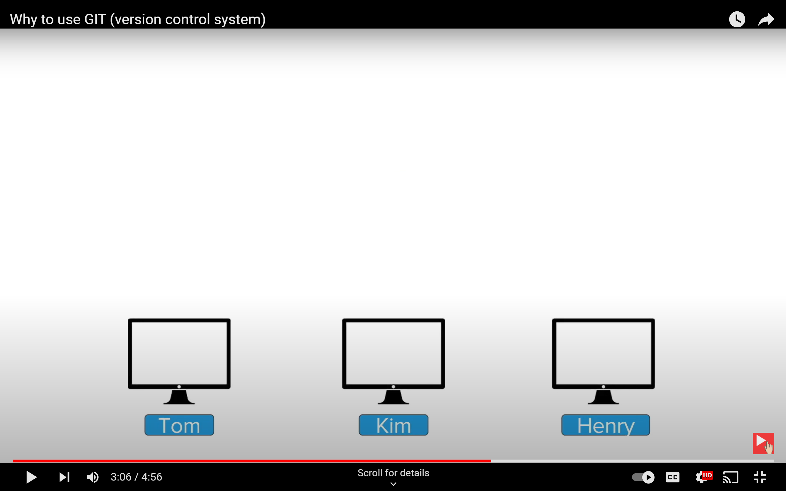
Git Add
Git Push
Git Push
Git Push
Git Commit
Git Clone
Git Clone
Git Clone
Project
Project
Project
Powell Menezes

Slide 11
Agenda
What is Git & GitHub
Basic Functions
Let’s see some examples
Hosting EDA using GitHub Pages and Jekyll
Powell Menezes

Slide 12
Problems
You had a code that worked, you made a bunch of changes and saved it, which broke the code, and now you just want the working version back
Accidentally deleted a critical file, hundreds of lines of code gone
Somehow messed up the structure/contents of your code base, and want to just “undo” the crazy action you just did!
Hard drive crash!!!! Everything’s gone, the day before deadline!
Whose computer stores the "official" copy of the project?
Will we be able to read/write each other's changes?
Lets just email changed files back and forth! Yay!
What happens if we both try to edit the same file?
What happens if we make a mistake and corrupt an important file?
How do I know what code each teammate is working on?
How do we know who added this code piece?
Powell Menezes

Slide 13

Version control System
Version control System is all about managing multiple versions of documents, programs, web sites, etc.
Almost all “real” projects use some kind of version control
Essential for team projects, but also very useful for individual projects
Some well-known version control systems are CVS, Subversion, Mercurial, and Git
CVS and Subversion use a “central” repository; users “check out” files, work on them, and “check them in”
Mercurial and Git treat all repositories as equal
Powell Menezes

Slide 14
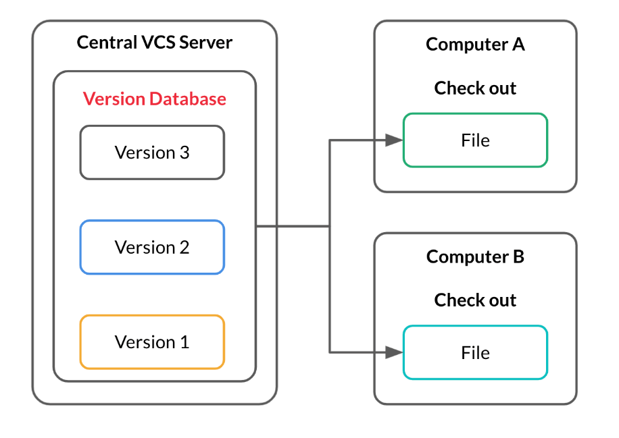
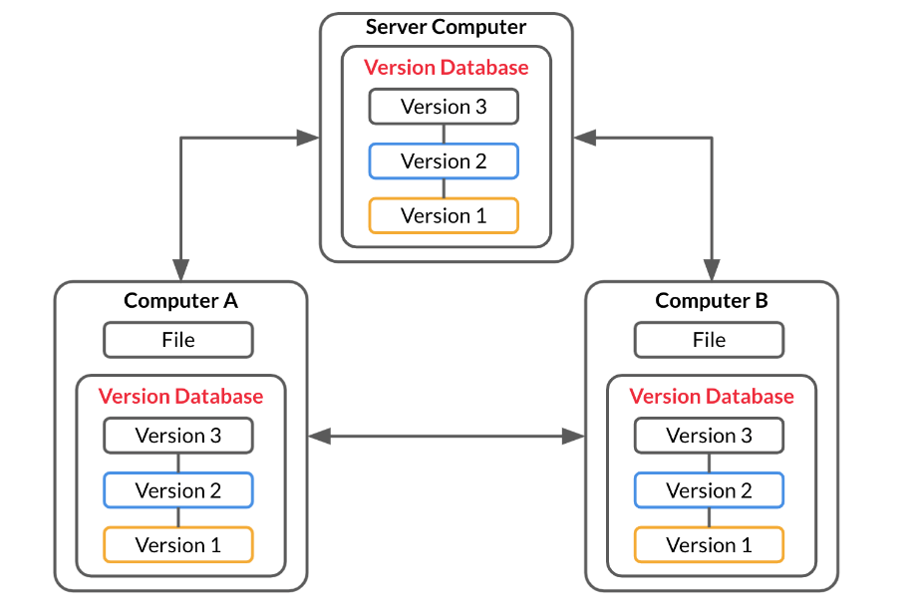
Why Git
Central Version control system (CVCS)
Distributed Version control system (DVCS)
As shown in the above diagram, the entire database of different versions is present on the local machines of developers as well as the central server. Even if the central server crashes, this database is available on all the local machines as well.
Powell Menezes

Slide 15



What is Git & GitHub ?
What is Git?
Git is a widely used Version Control System (VCS) that lets you keep track of all the modifications you make to your code. This means that if a new feature is causing any errors, you can easily roll back to a previous version.
What is GitHub?
GitHub is a widely used platform for version control that uses Git at its core. It lets you host the remote version of your project from where all the collaborators can have access to it.
Version control system that lets you manage and keep track of your source code history
Cloud-Based hosting service that lets you manage Git repositories

Slide 16


Jekyll
Jekyll is a static site generator with built-in support for GitHub Pages and a simplified build process. Jekyll takes Markdown and HTML files and creates a complete static website based on your choice of layouts. Jekyll supports Markdown and Liquid, a templating language that loads dynamic content on your site.
https://jekyllrb.com/
Static websites, do not use a database to store information; instead, all information to be displayed on each webpage is already contained in an HTML file for that webpage. The HTML pages that make up a static site can be completely written by hand, or you can offload some of this work using something like Jekyll.
Free hosting with GitHub Pages

Slide 17
Why Story telling is essential?
Memorability- A study by Stanford professor Chip Heath found 63% could remember stories, but only 5% could remember a single statistic. People hear statistics, but they feel stories
Most of the people in an organization cannot understand the outcome of analytics, however they do need proof of analysis and data.
Data storytellers help an organization to figure out the various types of stories that can be told with data –reporting stories, explanatory stories, predictive stories, causation stories, correlation stories, etc.
The main goal of big data analytics is to influence how someone takes an action or makes a decision. you cannot convince your stakeholders for a change unless they understand what insights you have gathered.
It is boring and time consuming for stakeholders to look at all the quantitative analysis
Powell Menezes

Slide 18

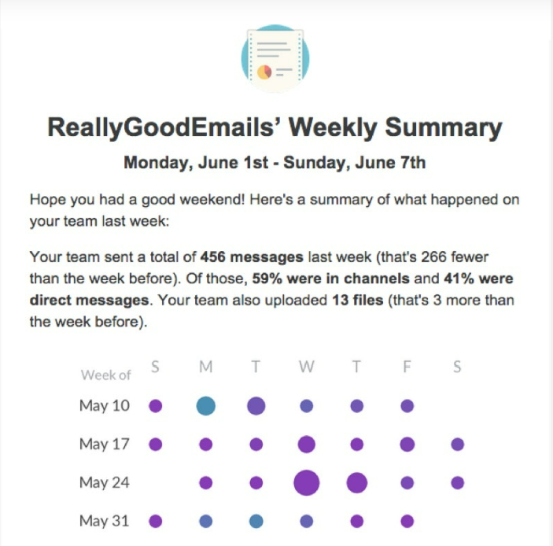
Why Story telling is essential?
Powell Menezes

Slide 19
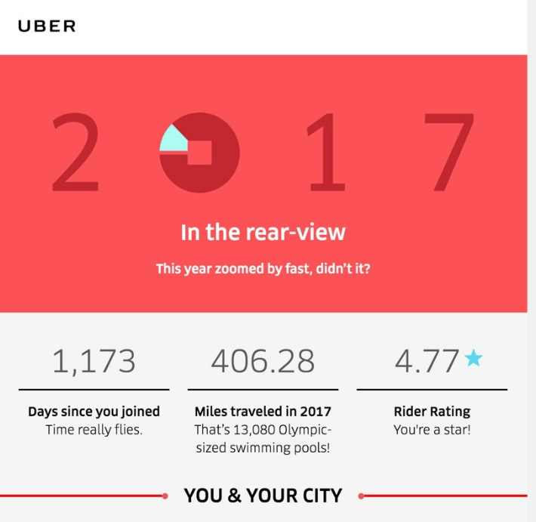
Why Story telling is essential?
Powell Menezes

Slide 20
How to tell effective Data Story?
Define Your Objectives and Know Your Audience
Identify a Compelling Narrative
Be Objective and Transparent
Choose the Right Data Visualization Method
Make Your Data Story Insightful
Create Synergies Between Data Storytelling and Content
Powell Menezes

Slide 21
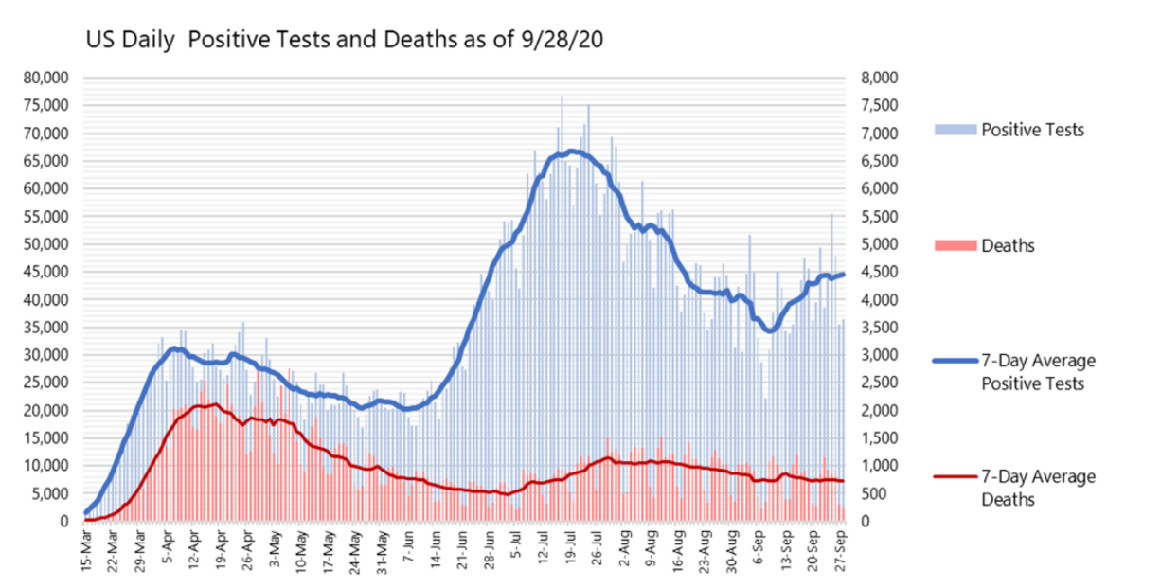
Identify a Compelling Narrative - Trend
Powell Menezes

Slide 22
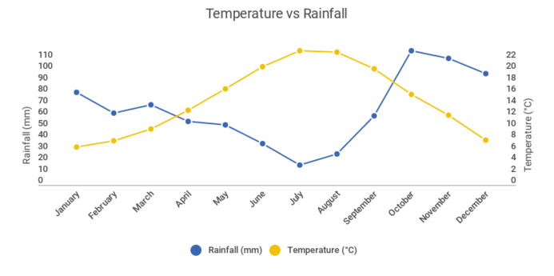
Identify a Compelling Narrative - Comparison
Powell Menezes

Slide 23
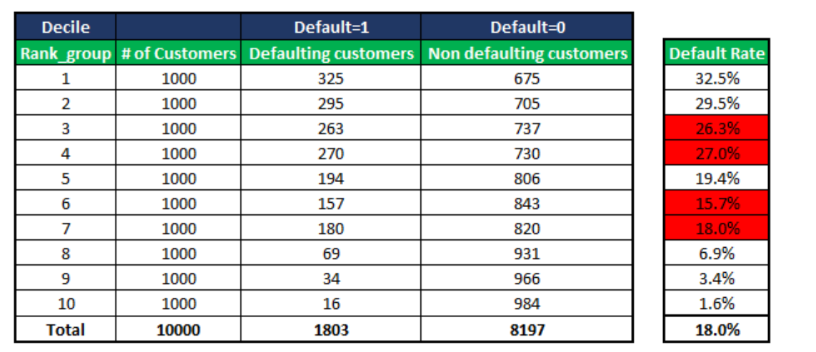
Identify a Compelling Narrative – Rank order
Powell Menezes

Slide 24
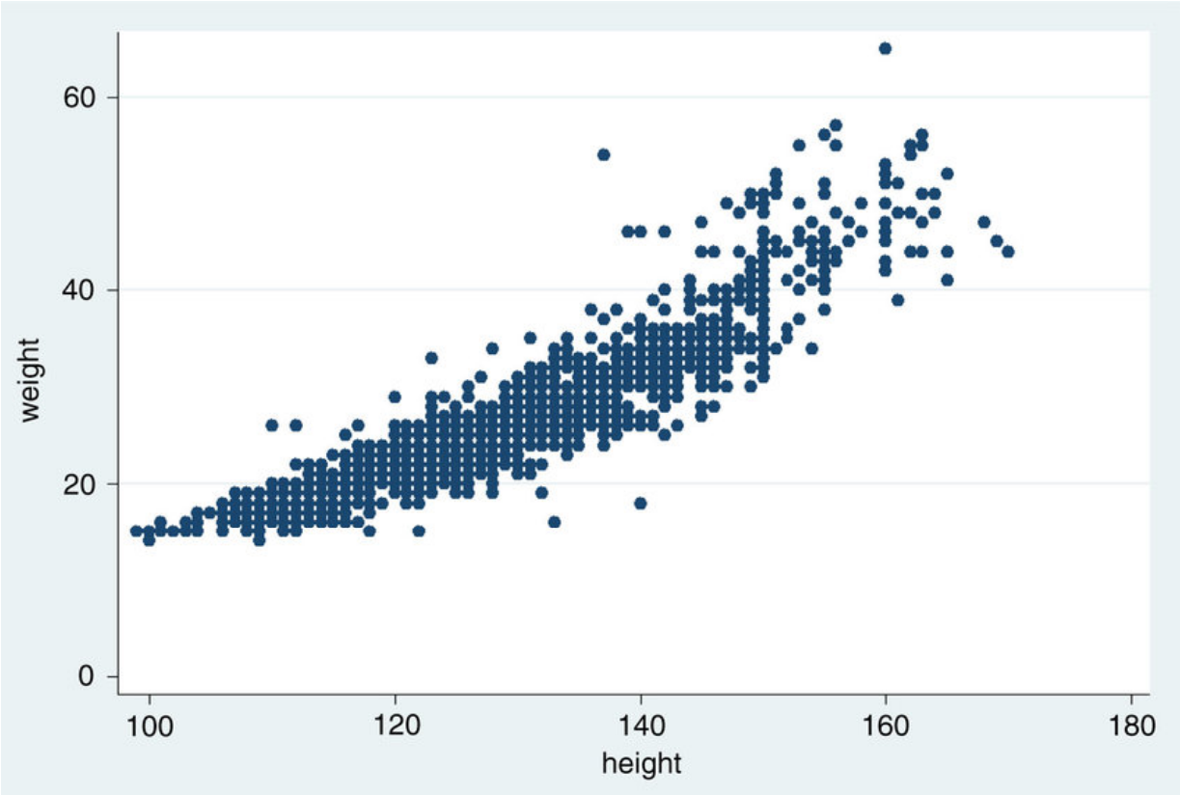
Identify a Compelling Narrative – Statistical Relationship
Powell Menezes

Slide 25
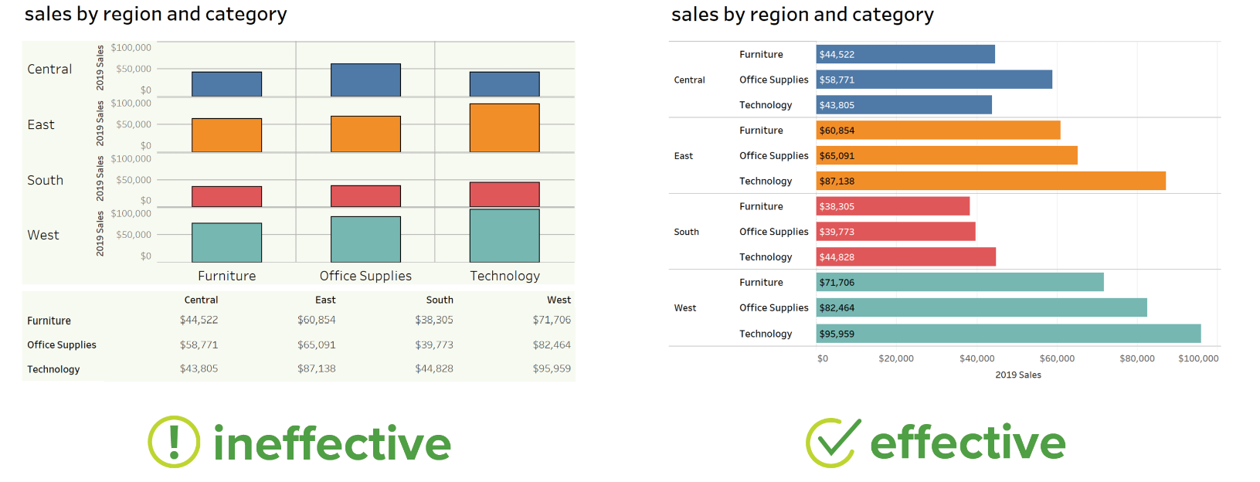
Choose the Right Data Visualization Method
Powell Menezes

Slide 26
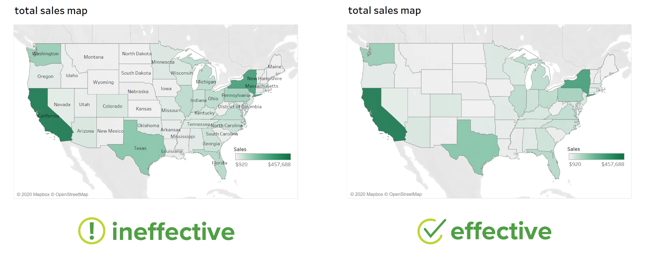
Choose the Right Data Visualization Method
Powell Menezes

Slide 27
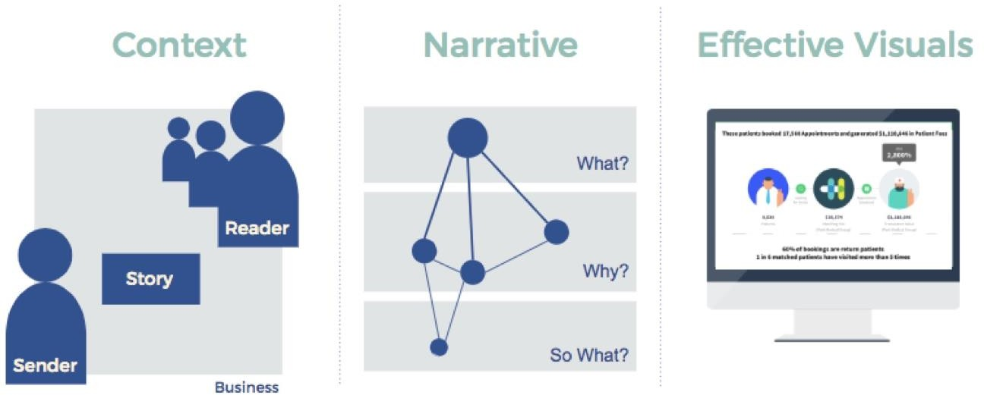
Flow of Storytelling
Powell Menezes

Slide 28
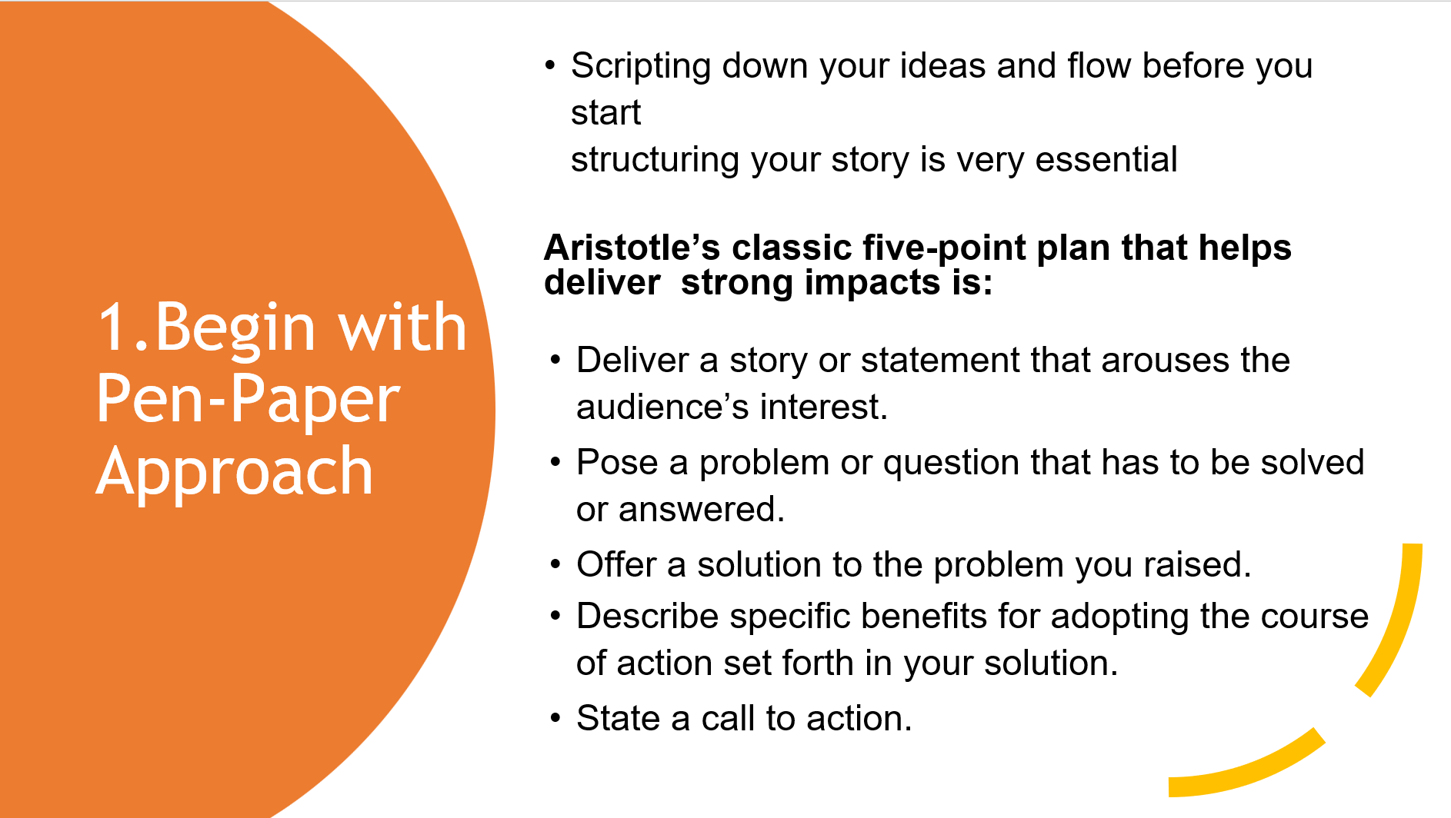
Different Methods to create stories
Powell Menezes

Slide 29
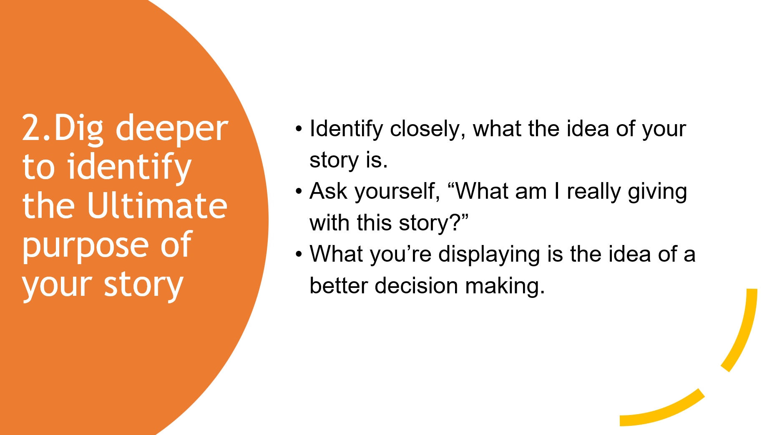
Different Methods to create stories
Powell Menezes

Slide 30
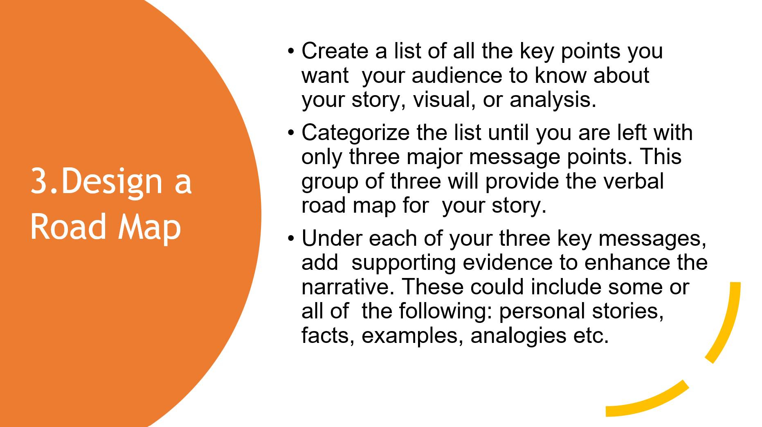
Identify a Compelling Narrative – Statistical Relationship
Powell Menezes

Slide 31
Identify a Compelling Narrative – Statistical Relationship
Powell Menezes

Slide 32
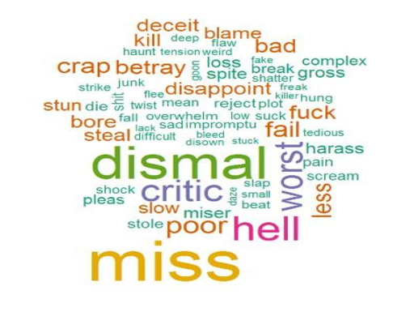
Types of Data and Suitable Charts
1. Textual Data
One of the best-suited visualizations for textual data is the WordCloud. The wordcloud brings the more frequent ones to the center and enlarges them, giving us a clear picture of what the general idea of the text depicts.
Powell Menezes

Slide 33
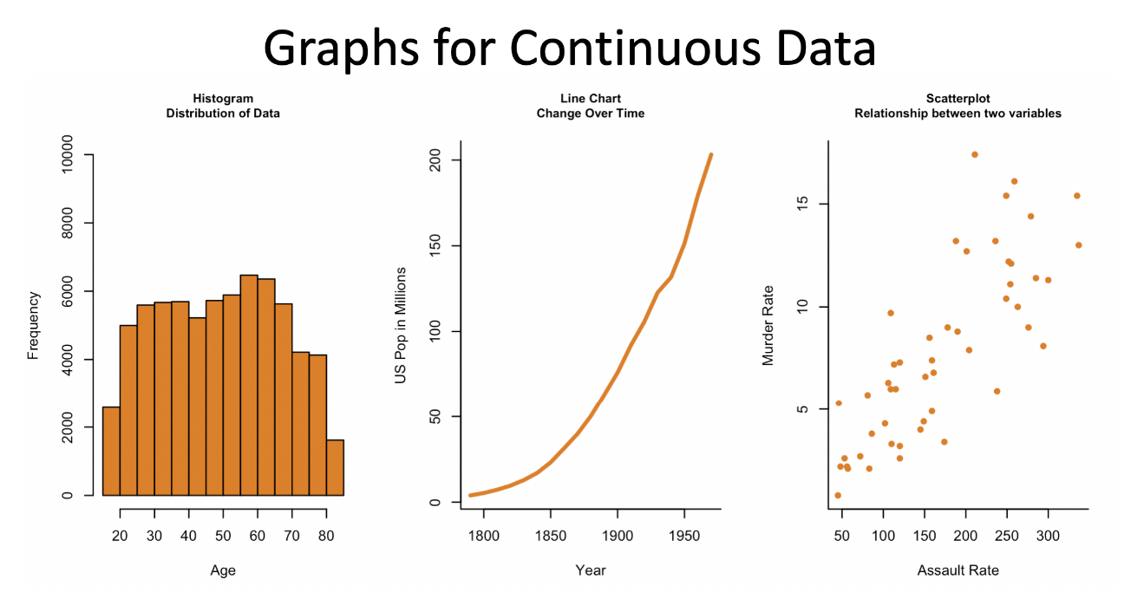
Types of Data and Suitable Charts
Powell Menezes

Slide 34
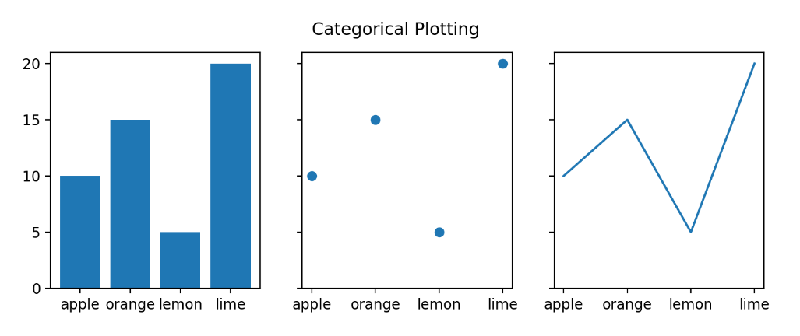
Types of Data and Suitable Charts
Powell Menezes

Slide 35
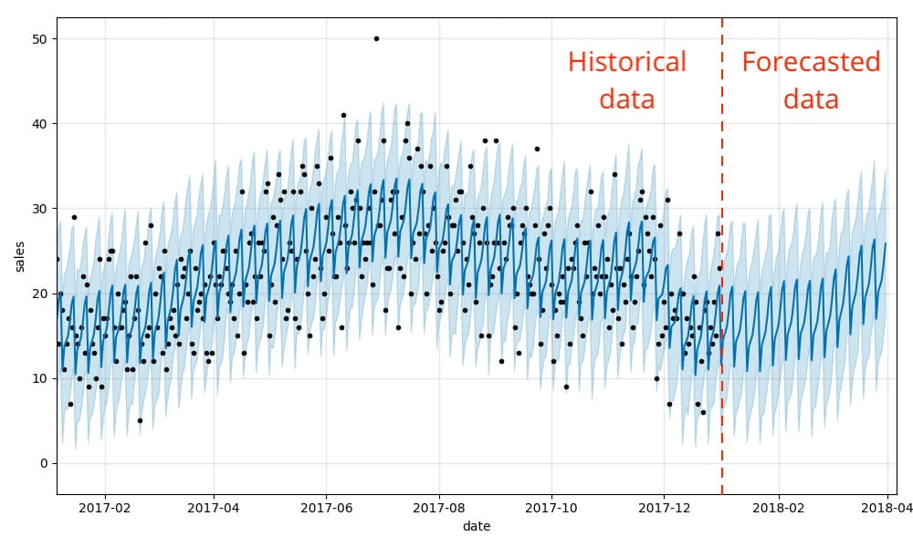
Types of Data and Suitable Charts
Powell Menezes

Slide 36
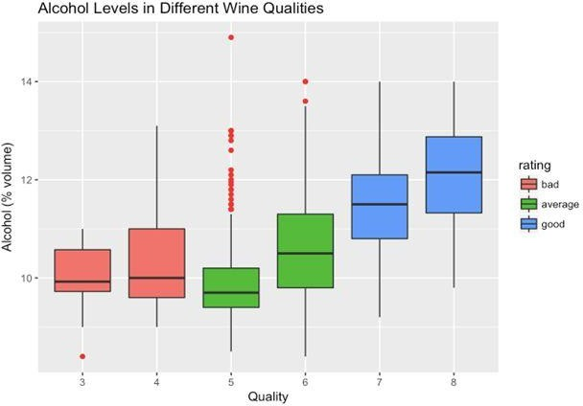
Storytelling during Predictive Model building
Powell Menezes

Slide 37

Demo
Netflix Dataset
Powell Menezes

Slide 38

#LifeKoKaroLift
Thank You!
Powell Menezes

